Slide 1
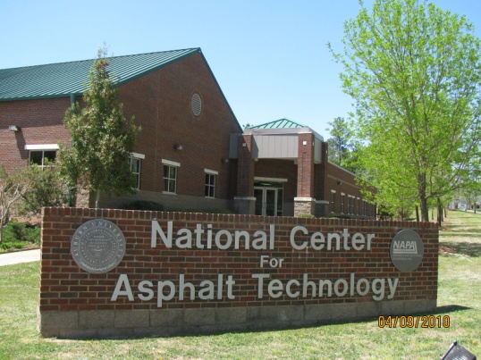
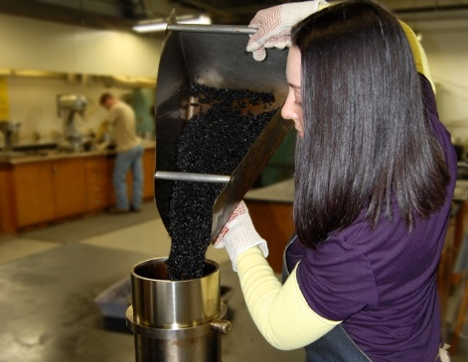
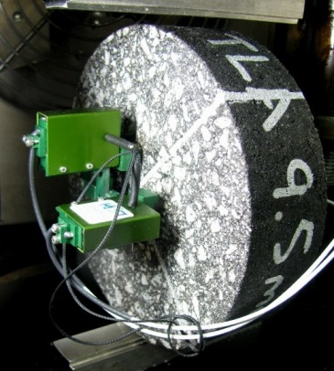
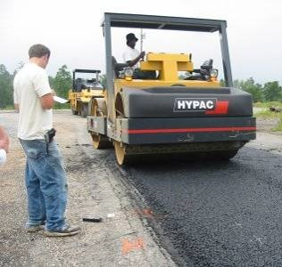
National Performance of High Recycled Mixtures

Slide 2
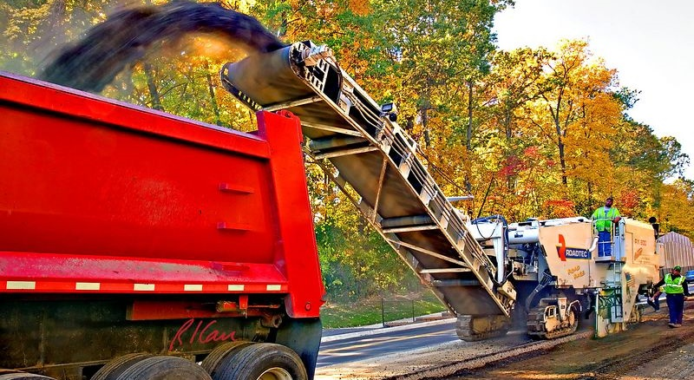
Outline
Trends in RAP and RAS usage and practices
Motivations for higher recycled contents
Barriers to higher recycled contents
Research and future directions

Slide 3
Estimates of RAP Usage
NAPA surveys estimate that the national average RAP content increased from 16.2% in 2009 to 20.4% in 2014.
RAP contents tend to be higher in commercial projects compared to government projects.
RAP usage varies considerably from state to state.

Slide 4
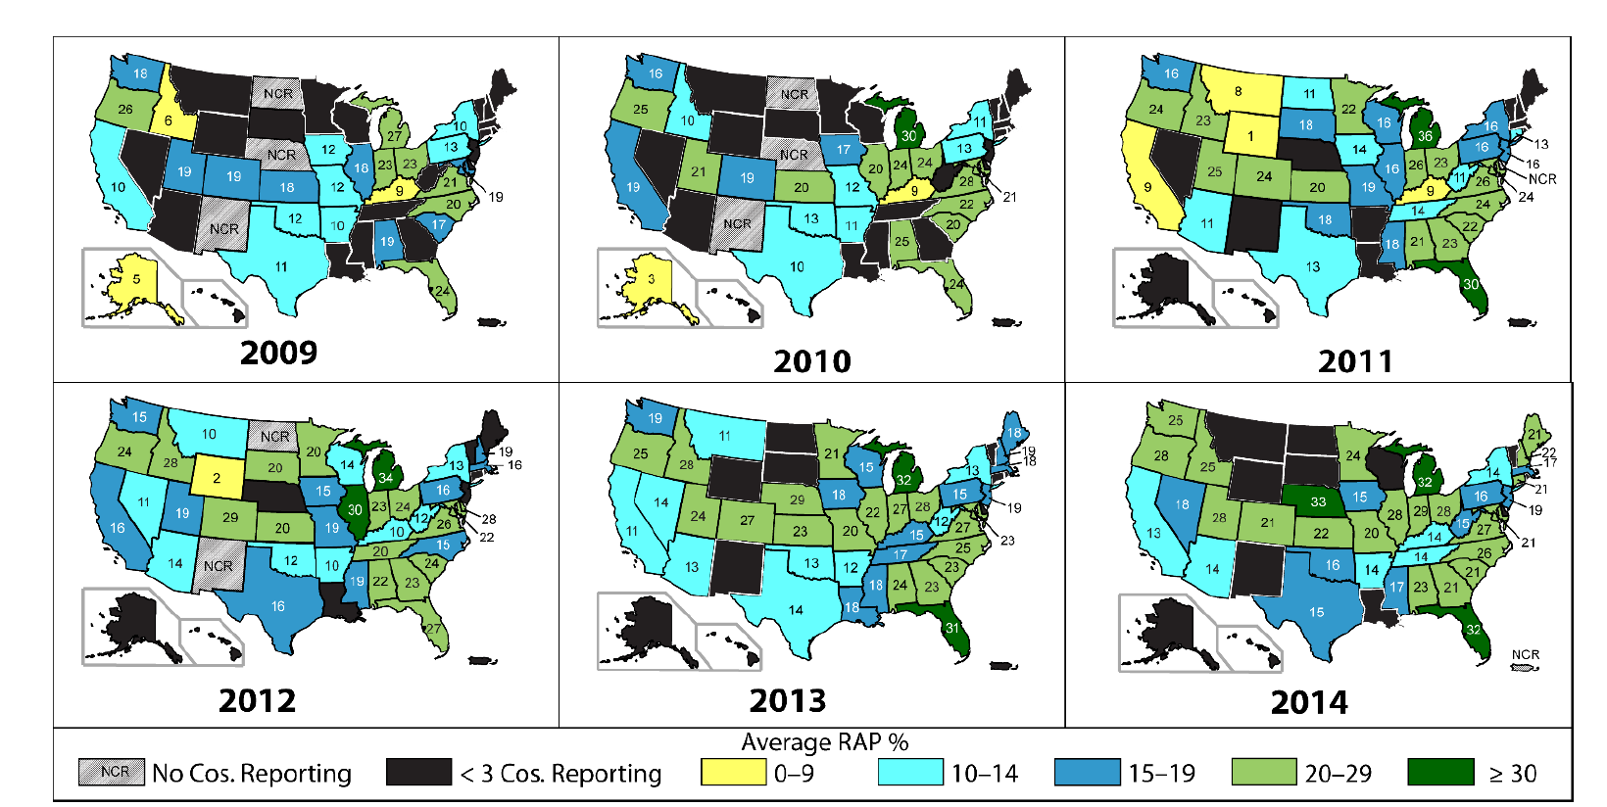
Average RAP contents by state
NAPA IS 138, 2015

Slide 5
Motivations for Higher RAP Contents
Environmental & Sustainability benefits
Economic savings

Slide 6
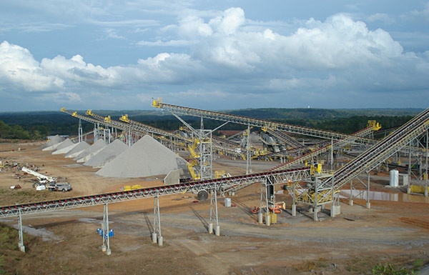
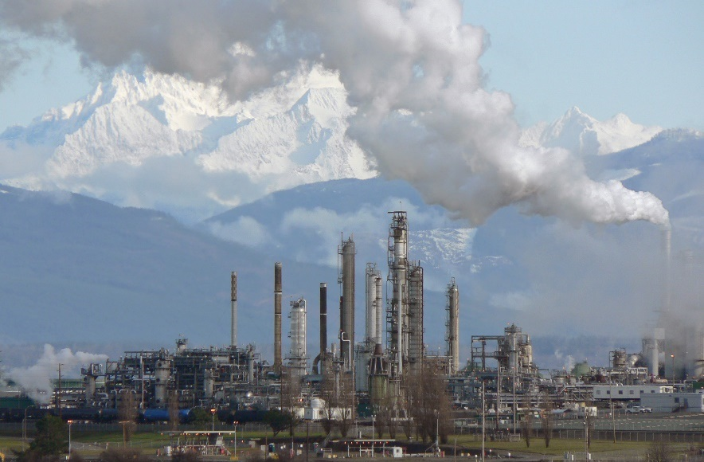
Conservation of Materials
At an average RAP content of 20%, we conserve over 66 million tons of aggregate and 9 million barrels of asphalt each year.

Slide 7
The average RAP content in Japan is 47%

Slide 8
Notes:
Over the last decade asphalt binder prices tripled and this put tremendous pressure to try to be more economical and cut costs in mix designs and mix production.

Slide 9
Current RAP Practices
In most (not all) places across the USA…
Project millings become property of contractor
Urban contractors have excess supplies of RAP
Processing options for RAP
no additional processing for single source milling stockpiles
blending & crushing: multiple source stockpiles
fractionating: RAP contents >30%

Slide 10
Reasons why Contractors use less RAP than allowed
Availability of RAP
Requirement to use a softer virgin binder
Limited availability and/or tankage issue
Requirement to recover and Test RAP binder
Ability to control the quality of the mix
Moisture
Amount of material passing no. 200 sieve
Workability
RAP variability

Slide 11
Barriers to Higher RAP Contents
History and Perceptions
Performance of high RAP content pavements
Concerns about quality and consistency of RAP
Technology Limitations
Current mix design system
Relies on VMA & therefore aggregate bulk specific gravities
Does not adequately consider composite binder properties
Need reliable performance tests

Slide 12
Performance Study of Asphalt Pavements with Greater than 25% RAP
LTPP SPS-5 pavement sections
18 U.S. states and Canadian provinces
Eight 500 ft. test sections
Rehabilitated sections compared
2” vs 5”overlay thickness
RAP (30%) vs virgin mixes
Milled vs unmilled surface preparation
Projects range in age from 6 to 17 yrs

Slide 13
SPS-5 Project Locations

Slide 14
ANOVA: Rutting

Slide 15
ANOVA: Fatigue Cracking

Slide 16
ANOVA: Transverse Cracking

Slide 17
ANOVA: International Roughness Index

Slide 18
Conclusions on LTPP SPS-5
Based on a long-term performance analysis of a large number of projects across North America…
Pavements using ≥ 30% RAP performed well, and in most cases, perform equal or better than virgin pavements
Transverse and fatigue cracking were observed at higher percentages in pavements with RAP compared to pavements with all virgin materials.
Higher percentages cracking did not impact overlay lives
Mix designs on several projects indicate high dust contents and low asphalt contents for RAP mixes.

Slide 19
Barriers to Higher RAP Contents
History and Perceptions
Performance of high RAP content pavements
Concerns about quality and consistency of RAP
Technology Limitations
Current mix design system
Relies on VMA & therefore aggregate bulk specific gravities
Does not adequately consider composite binder properties
Need for reliable performance tests

Slide 20
NCAT Research on Using Recycled Materials
NCHRP 9-46: high RAP content mix design
Lab studies on how to improve cracking resistance for mixes containing RAP and RAS
NCHRP 9-53: Combining RAS & WMA
Test Track experiments in 3rd, 4th, 5th, and 6th cycles
High RAP contents
RAS
GTR

Slide 21
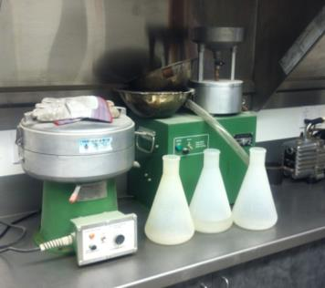
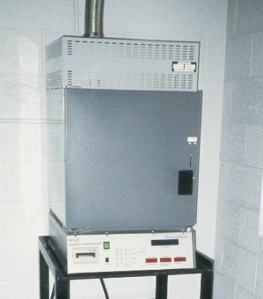
RAP Aggregate Bulk Specific Gravity
Method 1: Recover aggregate using a solvent extraction, then conduct AASHTO T84 and T85 on the fine and course fractions like any other aggregate.
Method 2: Recover aggregate by the ignition method, then conduct AASHTO T84 and T85 on the fine and course fractions like any other aggregate.

Slide 22
RAP Aggregate Bulk Specific Gravity
Method 3: Estimated G_{sb} from G_{mm} & P_{ba}
Determine G_{mm} (w/ dryback) of RAP sample
Calculate G_{se} using Eq. 1:
Estimate the absorbed asphalt, P_{ba} , based on historical values for the plant location.
Calculate G_{sb} using Eq. 2:
Equation 1
Equation 2

Slide 23
Recommendations RAP Aggregate Gsb
One method of determining RAP aggregate Gsb will not work for all material types. Agencies should evaluate options to find the best method for their materials. The method that gives the lowest Gsb will result in the lowest mix VMA. This is desirable since it will lead to higher asphalt contents and better durability.

Slide 24
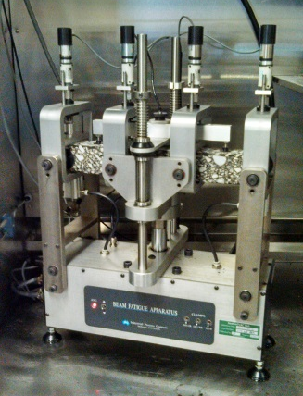
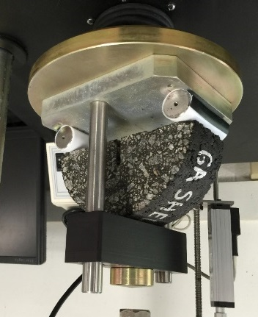
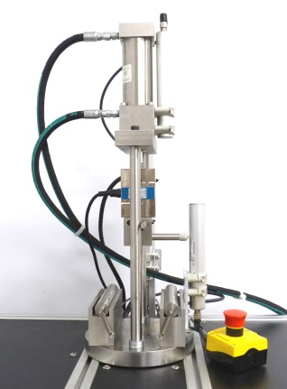
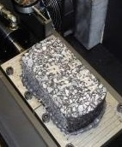
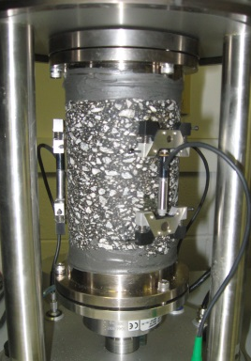
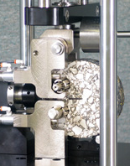
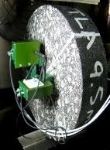
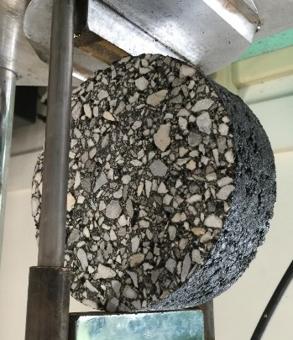
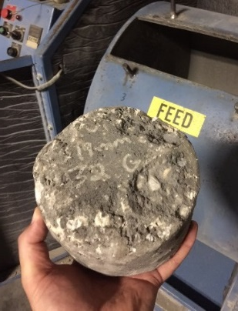
Some Tests for Assessing Cracking Resistance
BBF
SCB-LA
I-FIT
OT-TX
OT-NCAT
SVECD
DCT
Energy Ratio
Nflex Factor
Cantabro
Notes:
We need to find a cracking test that we can count on to indicate performance. Actually, it may be different tests for different forms of cracking. But this webinar is not going to get into the pros and cons of the different tests.

Slide 25
NCAT Test Track
2006: Moderate and High RAP Content Surface Mixes
Mixes with 20% and 45% RAP performed very well
30 million ESALS over 8 years
Minor differences in cracking support the use of softer binder for high RAP content mixes
Lab Tests: Bending Beam Fatigue, Energy Ratio, Texas Overlay Tester
Best correlation with top-down cracking in sections was IDT Creep Rate

Slide 26
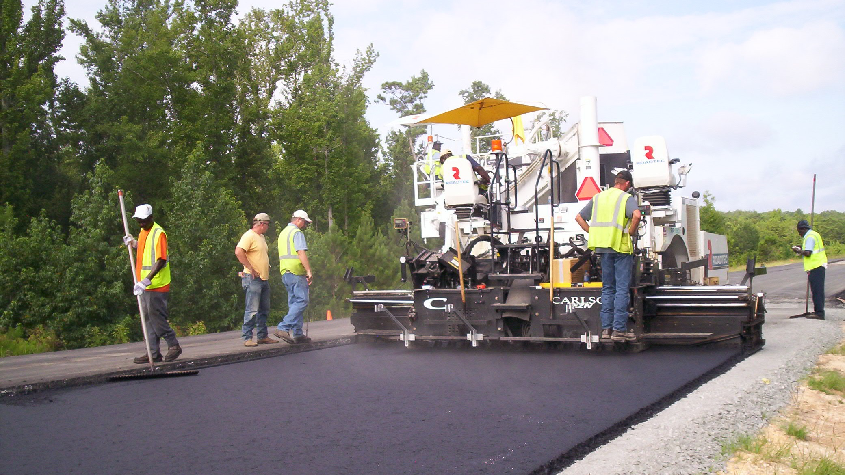
NCAT Test Track
2009: Virgin versus 50% High RAP Content – All Layers
Mixes with and without WMA
All sections performed very well
50% HMA section – no distress through 20 million ESALS
Lab Tests: BBF, Overlay Tester, SVECD
Best correlation with observed fatigue cracking was OT results extrapolated to measured strain level

Slide 27
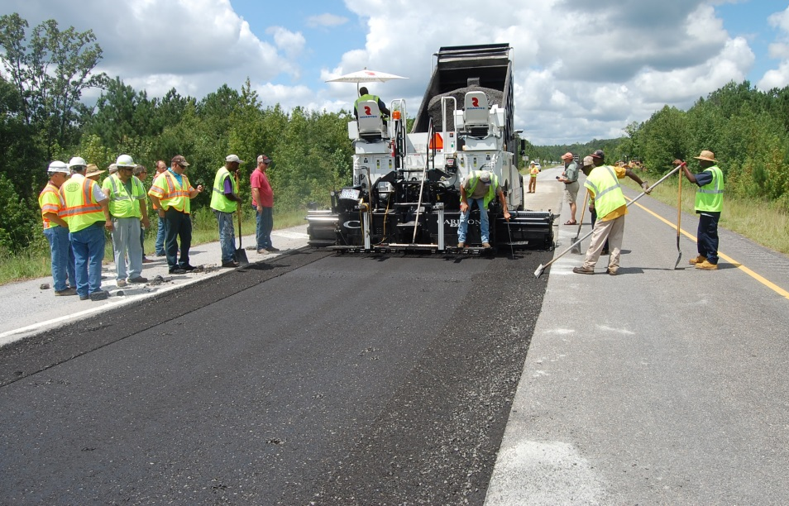
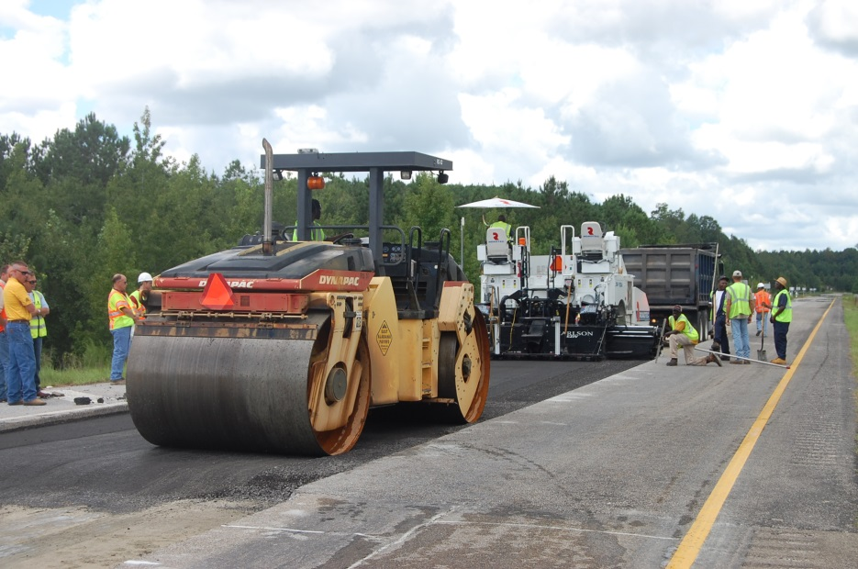
Cold Central Plant Recycling
Sponsored by Virginia DOT
Processed RAP 2% foamed asphalt and 1% cement
Serves as base layer with overlays of 4 inches and 6 inches
Objective: quantify the structural contribution (empirical and M-E)
Performance has been outstanding – no distress 11 MESALs and counting

Slide 28
NCAT Test Track
2015: Cracking Group Experiment: Top-Down Focus
7 surface mixes with a range of expected cracking resistance
Lab Tests: I-FIT, SCB-LTRC, Overlay Test, Energy Ratio, & others

Slide 29
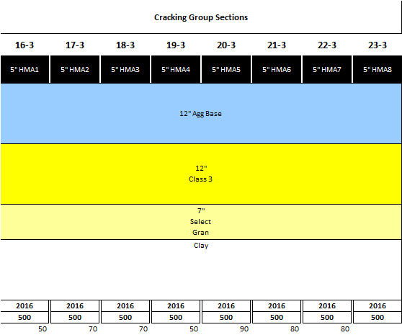
2016 MnROAD Thermal Cracking Experiment
Transition zones
16
17
18
19
20
21
22
23

Slide 30
Recycled Asphalt Shingles Usage
Hansen and Copeland, Annual Asphalt Pavement Industry Survey on Recycled Materials and Warm-Mix Asphalt Usage: 2009-2014
Notes:
Like RAP, RAS usage has been on the increase over the past 5 years. In 2013, there was a slight decrease in the national average; however, both DOT and other agency work increased. The decrease was seen in private work.

Slide 31
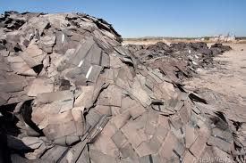
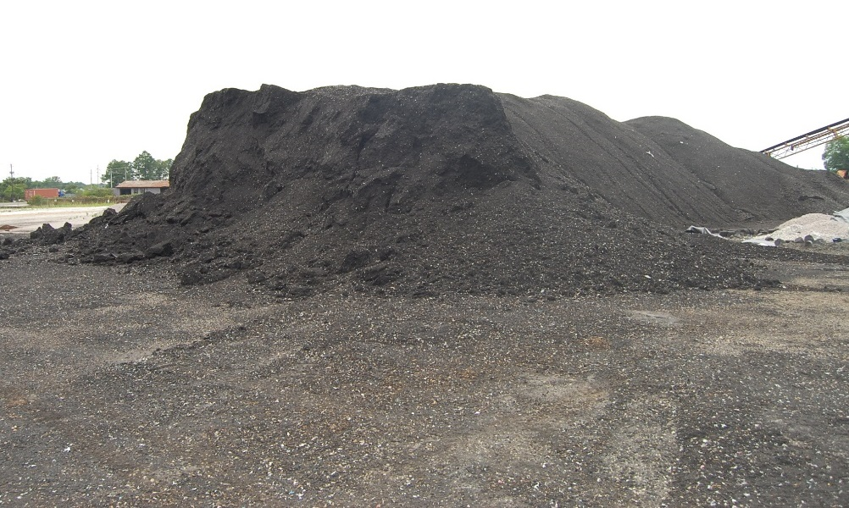
Recycling Asphalt Shingles
Currently used in about 37 states, but routinely for state DOT projects in only about a dozen states
Typically 3 to 5% RAS by weight of mix
Field performance has been mixed
Mix design approaches continue to evolve

Slide 32
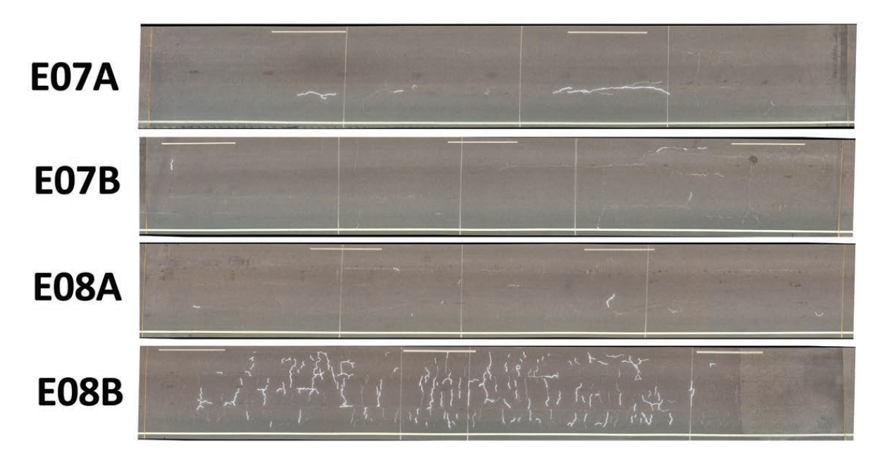
Performance of Mixes with RAS
Virgin Mix
PG 76-22 SBS
Virgin Mix
PG 76-22 GTR
20% RAP Mix
PG 76-22 SBS
20% RAP + 5% RAS
PG 76-22 SBS

Slide 33
Research and future directions
Validation of mix cracking tests
“Balanced” mix designs will replace volumetric-based mix designs
Rejuvenator formulations will mature
Much higher RAP content asphalt mixtures
Cold recycled 100% RAP (with some minor additives) as base layer for heavy traffic roads and as a primary structural layer in light traffic pavements.

Slide 34
Thank You!

